Slide 1
The Client Software Examples
Shyan-Ming Yuan
CS Department, NCTU
smyuan@gmail.com

Slide 2
The UDP Client Algorithm
Find the IP address and port number of the desired server.
gethostbyname()+ getservbyname()+ getprotobyname()
getaddrinfor()
Allocate a socket
Use socket(AF_INET, SOCK_DGRAM, )
Let UDP arbitrary select an unused port on the local host.
Set the socket to a dedcated remote server
connect()
Use send()/write() and recv()/read() to communicate with the server.
When the socket needs to communicate with multiple servers,
Use sendto() and recvfrom() to communicate with these servers.
Deallocate the socket – close() or shutdown()

Slide 3
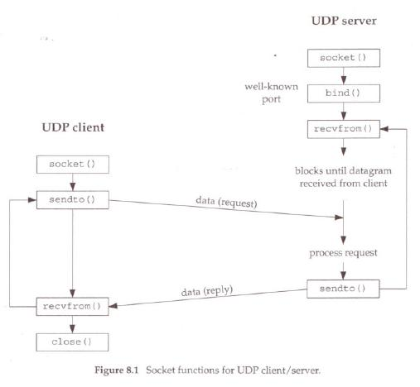
The UDP Client Server Paradigm Unconnected Mode
getaddrinfor
gethostbyname
getservbyname
getprotobyname

Slide 4
IP address and Port number – getaddrinfo
struct addrinfo hints;
memset(&hints, 0, sizeof(struct addrinfo));
hints.ai_family = AF_UNSPEC; /* Allow IPv4 or IPv6 */
hints.ai_socktype = SOCK_DGRAM; /* Datagram socket */
hints.ai_flags = 0;
hints.ai_protocol = 0; /* Any protocol */
struct addrinfo *result, *rp;
// host contains domain name or dotted-decimal
// service contains service name or stringed portnumber
getaddrinfo(host, service, &hints, &result);
int sfd; /* socket */
for (rp = result; rp != NULL; rp = rp->ai_next) {
sfd = socket(rp->ai_family, rp->ai_socktype, rp->ai_protocol);
if (sfd != -1) break; /* Success */
close(sfd);
}

Slide 5
Exchange Messages– sendto and recevfrom (getaddrinfo)
struct sockaddr_in sin; /* struct for holding receiver’s IP address */
socklen_t sin_addrlen; /* address length of sin */
sin_addrlen = sizeof(sin);
size_t len;
ssize_t nread, nchars;
char buf[BUF_SIZE];
while (fgets(buf, sizeof(buf), stdin)) { /* get data from stdin */
len = strlen(buf);
if (len == 1) exit(0);
// send data to the server pointed by the rp->ai_addr
nchars = sendto(sfd, buf, len, 0, rp->ai_addr, rp->ai_addrlen);
// receive echo back from the server
nread = recvfrom(sfd, buf, BUF_SIZE, 0, (struct sockaddr *)&sin, &sin_addrlen);
}

Slide 6
IP address and Port number – gethostbyname …
struct sockaddr_in sin; /* struct for holding IP address */
memset(&sin, 0, sizeof(sin));
sin.sin_family = AF_INET;
struct hostent *phe; /* pointer to host information entry */
phe = gethostbyname(host); /* host contains domain name of the server */
memcpy(&sin.sin_addr, phe->h_addr, phe->h_length);
sin.sin_addr.s_addr = inet_addr(host); /* host contains dotted-decimal IP */
struct servent *pse; /* pointer to service information entry */
pse = getservbyname(service, transport); /* service name & protocol name */
sin.sin_port = pse->s_port;
sin.sin_port=htons((unsigned short)atoi(service)); /* stringed port number */
struct protoent *ppe; /* pointer to protocol information entry*/
ppe = getprotobyname(transport); /* “udp” or tcp” */

Slide 7
Exchange Messages – sendto and recevfrom
int sfd; /* socket descriptor */
sfd=socket(AF_INET, SOCK_DGRAM, ppe->p_proto);
socklen_t sin_addrlen; /* address length of sin */
sin_addrlen = sizeof(sin);
size_t len;
ssize_t nread, nchars;
char buf[BUF_SIZE];
while (fgets(buf, sizeof(buf), stdin)) { /* get data from stdin */
len = strlen(buf);
if (len == 1) exit(0);
// send data to the server addressed by the sin
nchars = sendto(sfd, buf, len, 0, (struct sockaddr *)&sin, sin_addrlen);
// receive echo back from the server
nread = recvfrom(sfd, buf, BUF_SIZE, 0, (struct sockaddr *)&sin, &sin_addrlen);
}

Slide 8
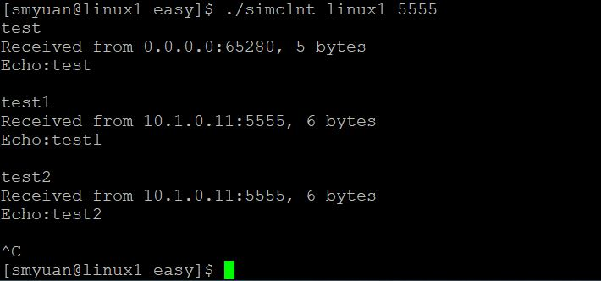
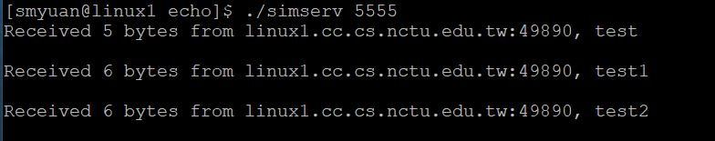
Simple UDP Echo Service

Slide 9
The UDP Client Server Paradigm– Psudo Connection mode
Client
Server
socket
socket
getaddrinfor
getaddrinfor
connect
bind
write/send
recvfrom
read/recv
sendto

Slide 10
Some useful functions
connectsock: connect to a TCP or UDP server
int connectsock(const char *host, const char *service,
const char *transport)
connectsock(host, service, “tcp”)
connectsock(host, service, “udp”)
passivesock: used by a server for binding to a well-known port and becoming passive
int passivesock(const char *service, const char *transport,
int qlen)
passivesock(service, “tcp”, qlen)
Passivesock(service, “udp”, 0)
errexit: print an error message and exit

Slide 11
The TCP Client Algorithm
Find the IP address and port number of the desired server.
gethostbyname()+ getservbyname()+getprotobyname()
getaddrinfor()
Allocate a socket – socket()
Let TCP arbitrary select an unused port on the local host.
Connect the socket to the remote server – connect()
Use send()/write() and recv()/read() to communicate with the server.
Deallocate the socket – close() or shutdown()

Slide 12
The TCP Client Server Paradigm
Client
Server
socket
socket
bind
listen
Connection request
generate a new socket
connect
accept
write/send
read/recv
Data socket
Data message
read/recv
write/send
Data message

Slide 13
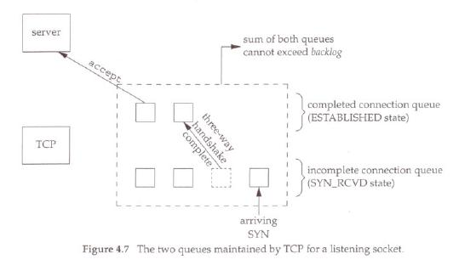
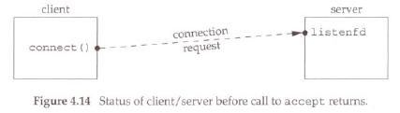
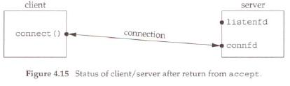
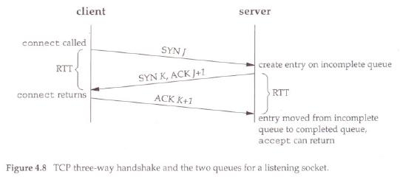

Slide 14
Some Important Facts
In UDP socket, a receiver uses recvfrom to retrieve the whole message received.
In TCP socket, a receiver uses read/recv to retrieve a specified number of bytes from the byte stream associated with the socket.

Slide 15
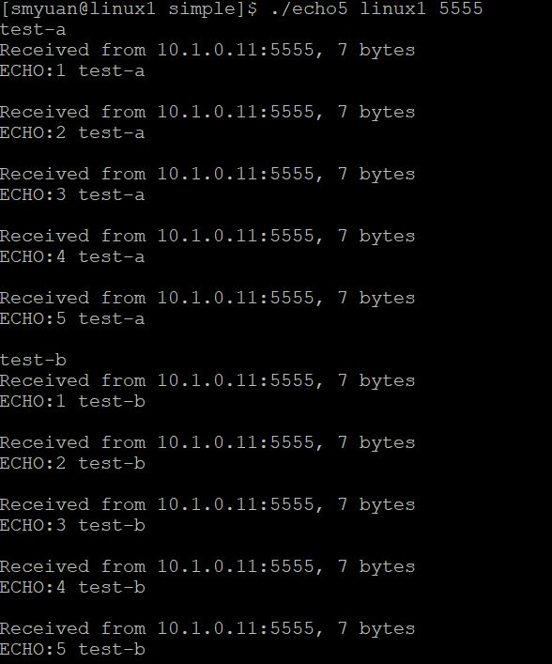
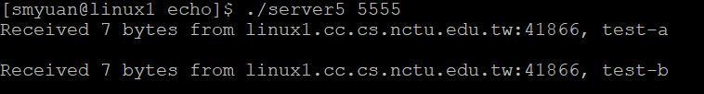
UDP Echo 5

Slide 16
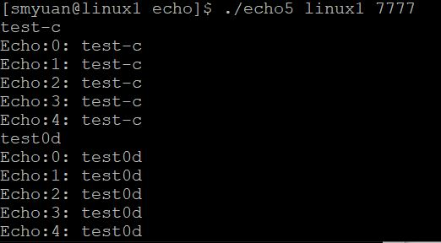
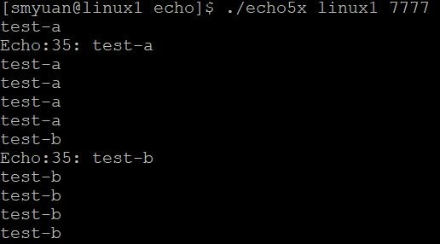

TCP Echo 5

